Slide 1
Project Management Integrated System
Access to ProMIS Timesheet module
Turin
November 2019
Contains confidential proprietary and trade secrets information of CNH Industrial. Any use of this work without express written consent is strictly prohibited.

Slide 2
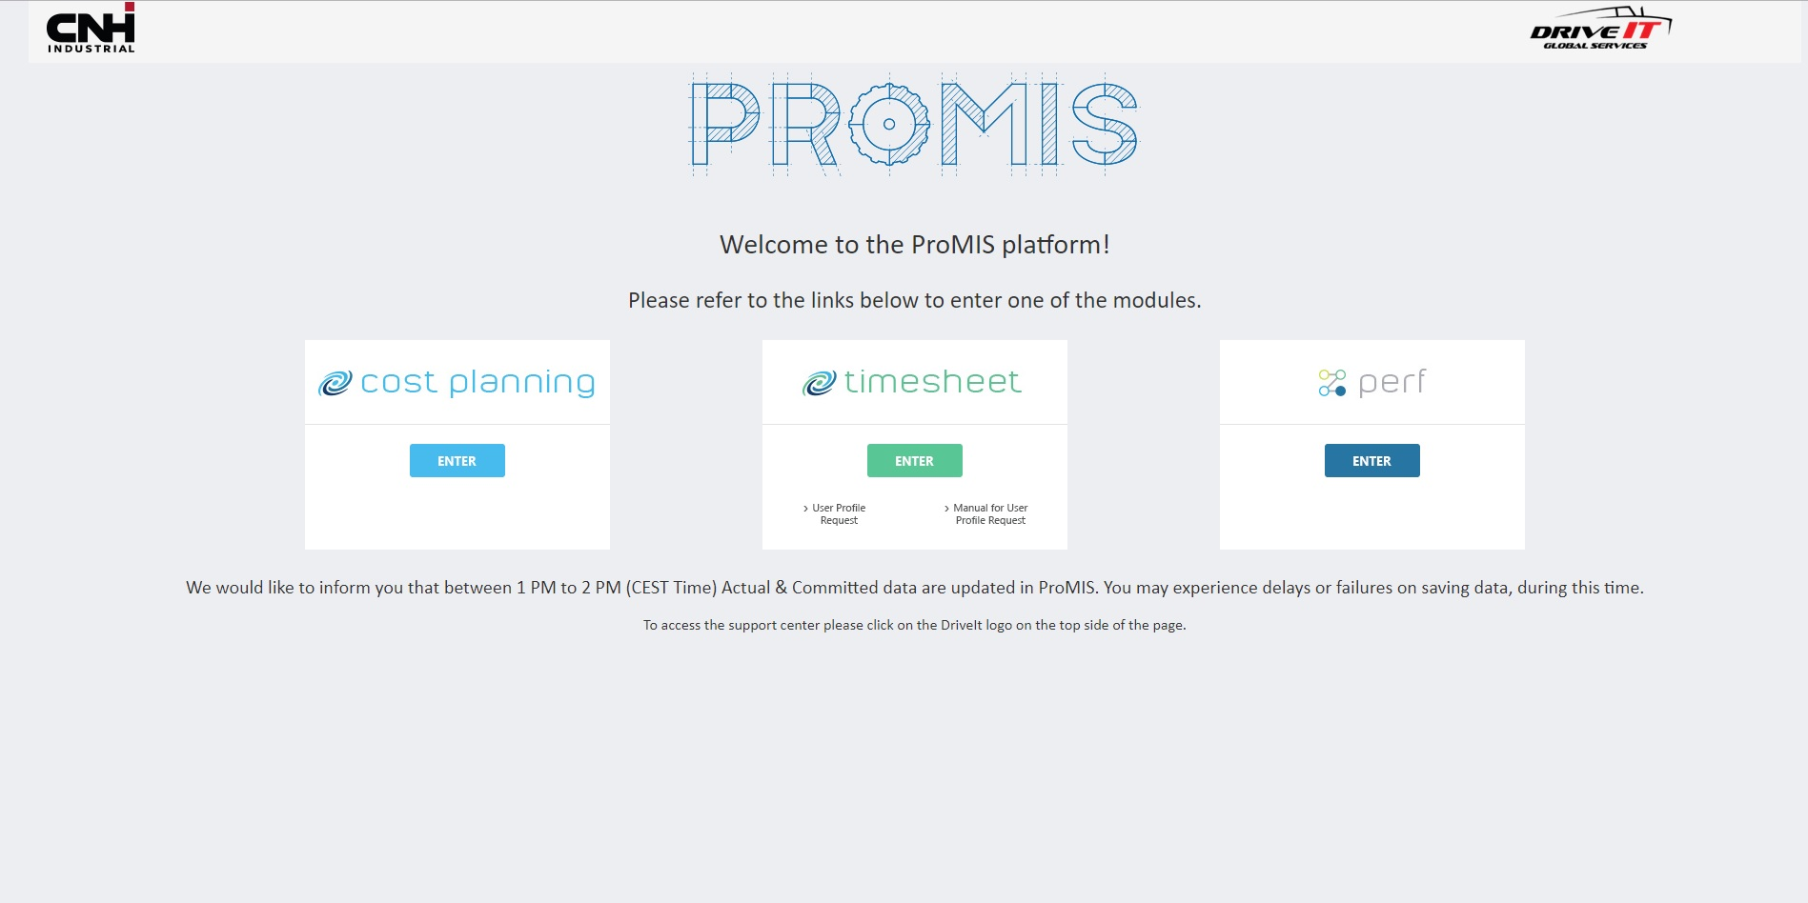
How to open a request for ProMIS TimeSheet access
Click to access Drive IT request form

Slide 3
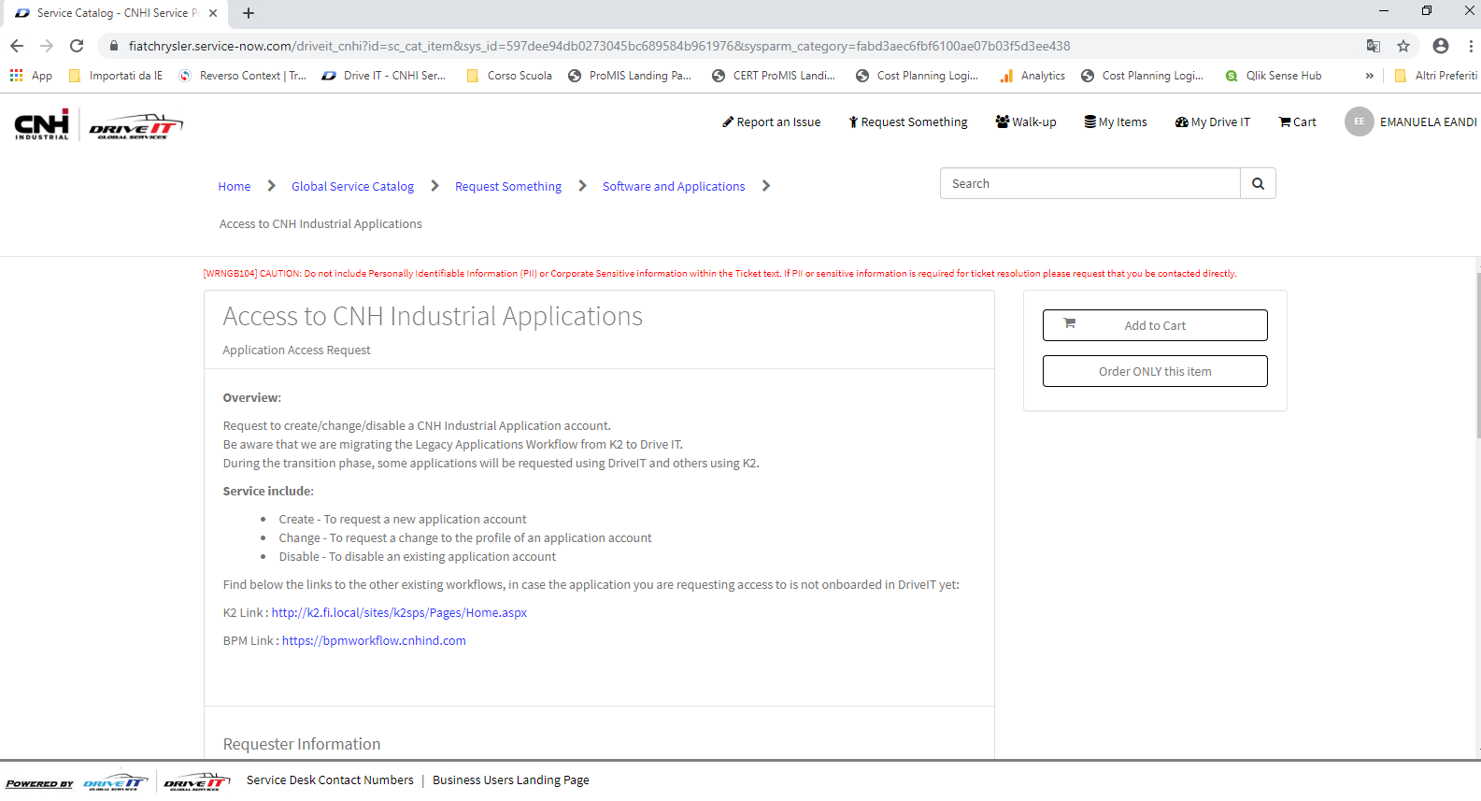
How to open a request for ProMIS TimeSheet access

Slide 4
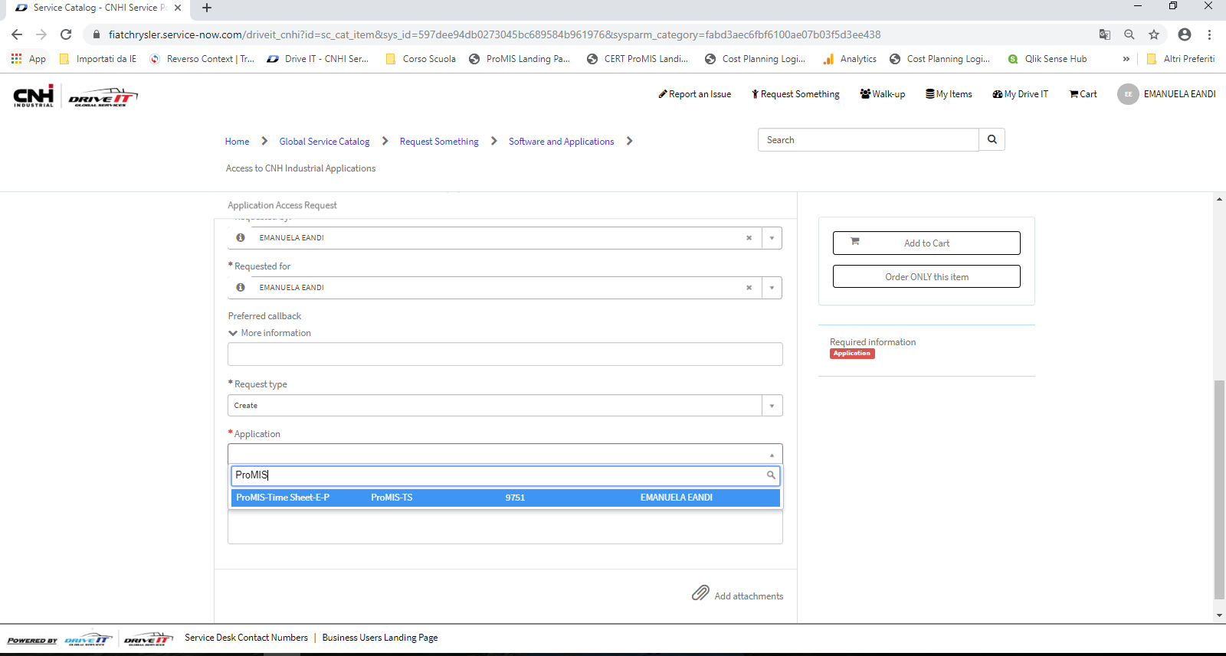
How to open a request for ProMIS TimeSheet access
Update «Requested For» field to request the user profile for another user
Set the field Request Type:
- Create: to request a new user profile
- Change: to update an existing user profile
- Delete: to remove an existing user profile
Required fields are marked
with an asterisk.
Application: ProMIS-Time Sheet-E-P

Slide 5
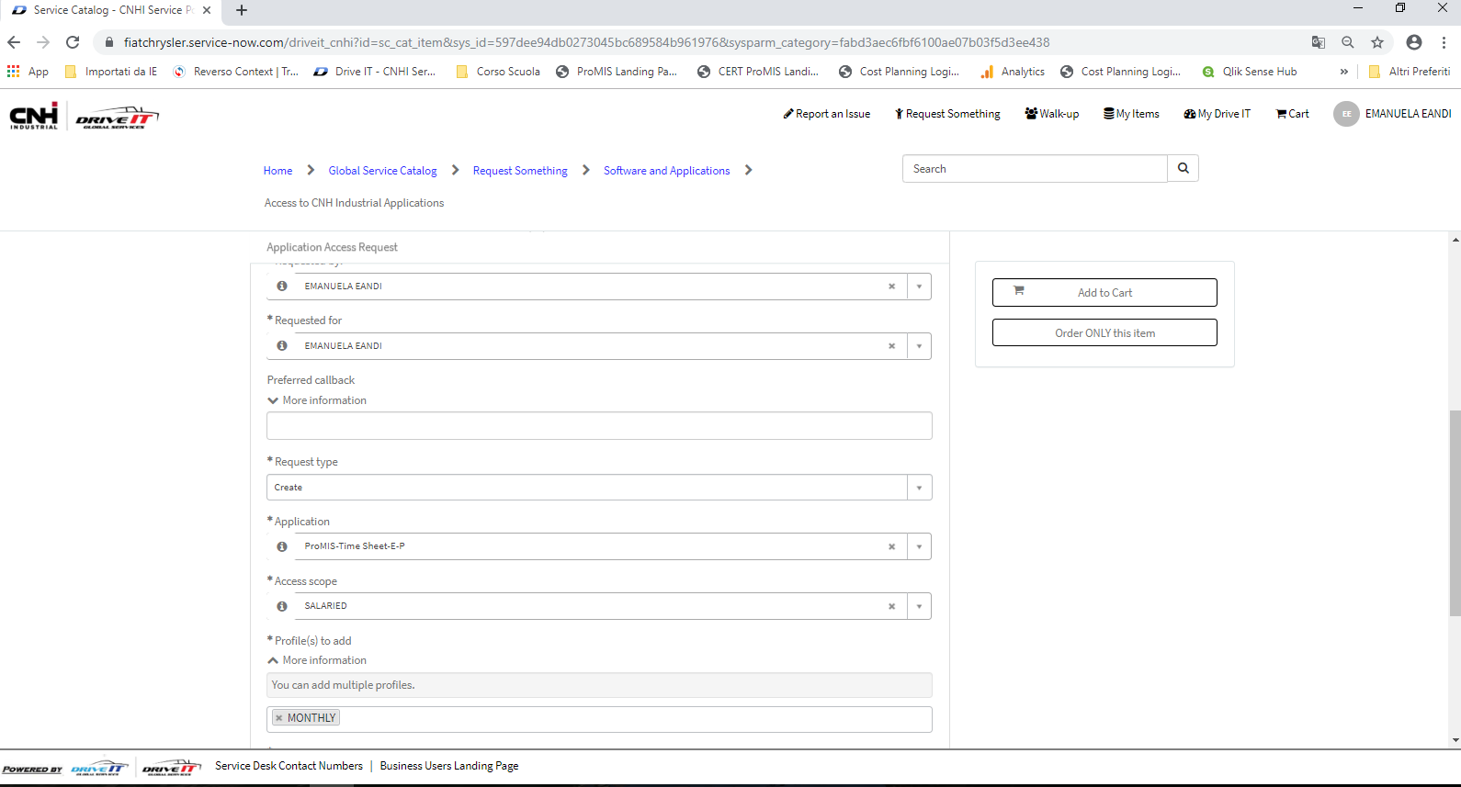
How to open a request for ProMIS TimeSheet access
Set the head category in access scope field:
Director
Hourly
Salaried
Set the view of timesheet in Profile field:
Monthly : to input total hours by month
Weekly: to input hours with daily details (weekly view)
Set only one value

Slide 6
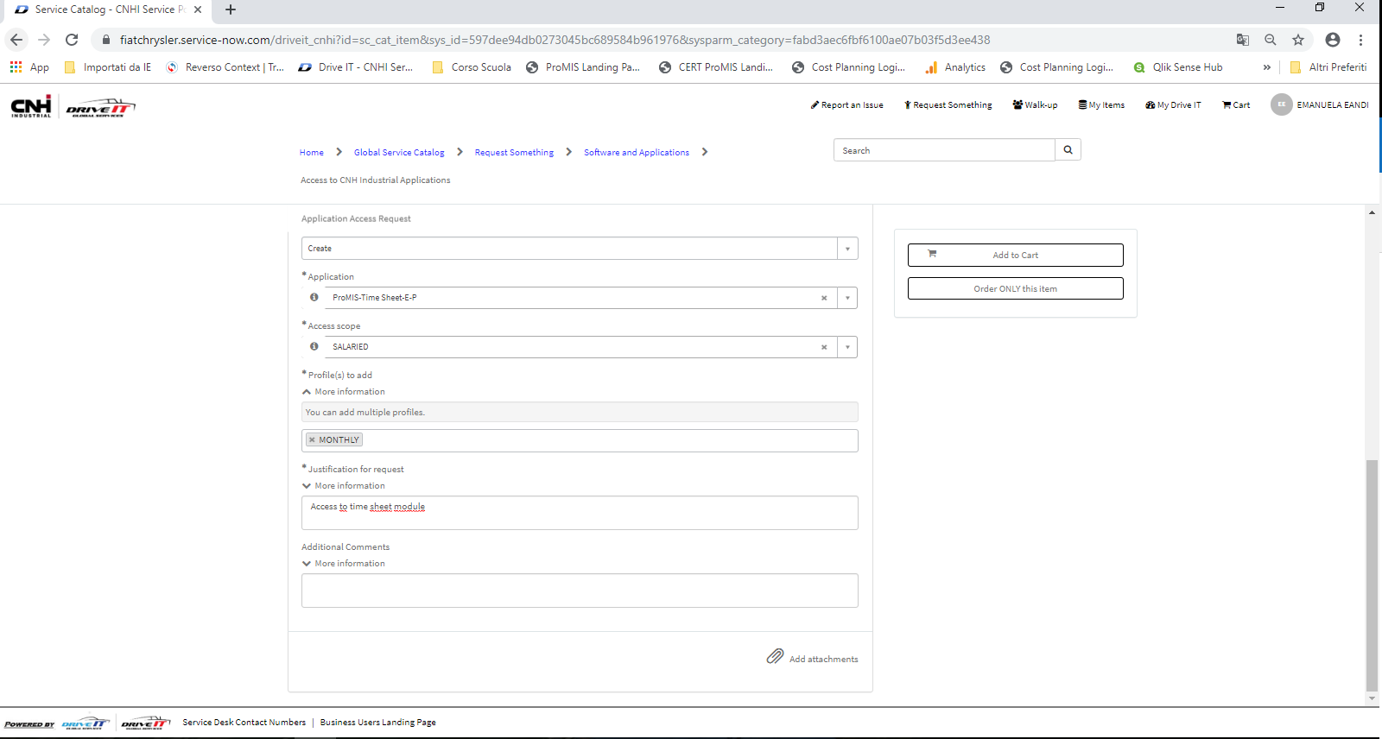
How to open a request for ProMIS TimeSheet access
Complete the description of the request with:
- Total hours by week
- Default PV area, in case of the user belonging to Product validation (Proto, Field, Bench)
To add an attachment, click on the paperclip: HR approval received by email if available

Slide 7
How to open a request for ProMIS TimeSheet access
Once you have filled out all required fields on the form, you are ready to submit your request.
“Order ONLY this Item” allows you to skip the cart completely, and
submit your request directly from the form.
“Add to Cart” will add the request to your cart. This way you can fill out
other requests and also add them to your cart and checkout all the
requests at once at later time. This option is usefull for site supervisor when requesting multiple profiles.

Slide 8
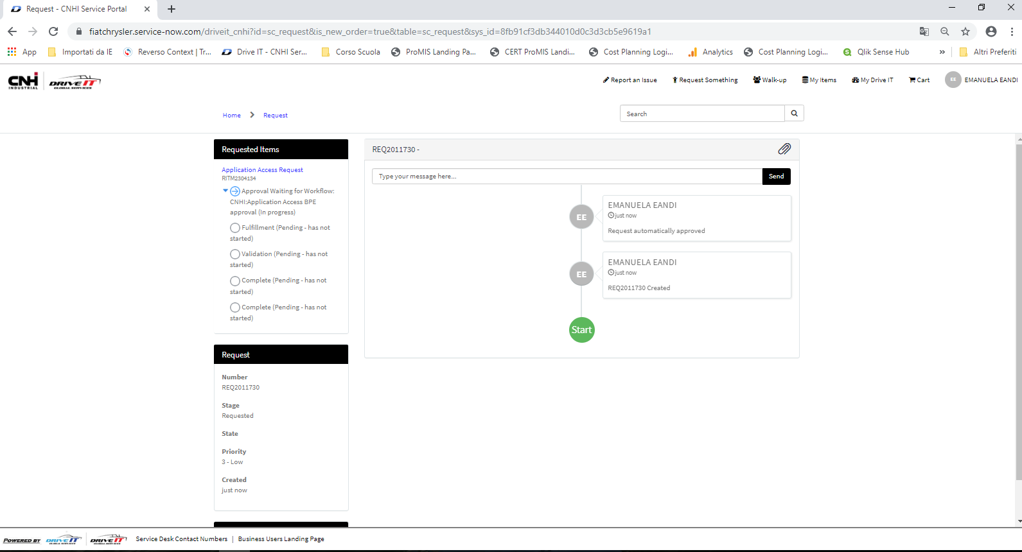
How to open a request for ProMIS TimeSheet access
Request created

Slide 9
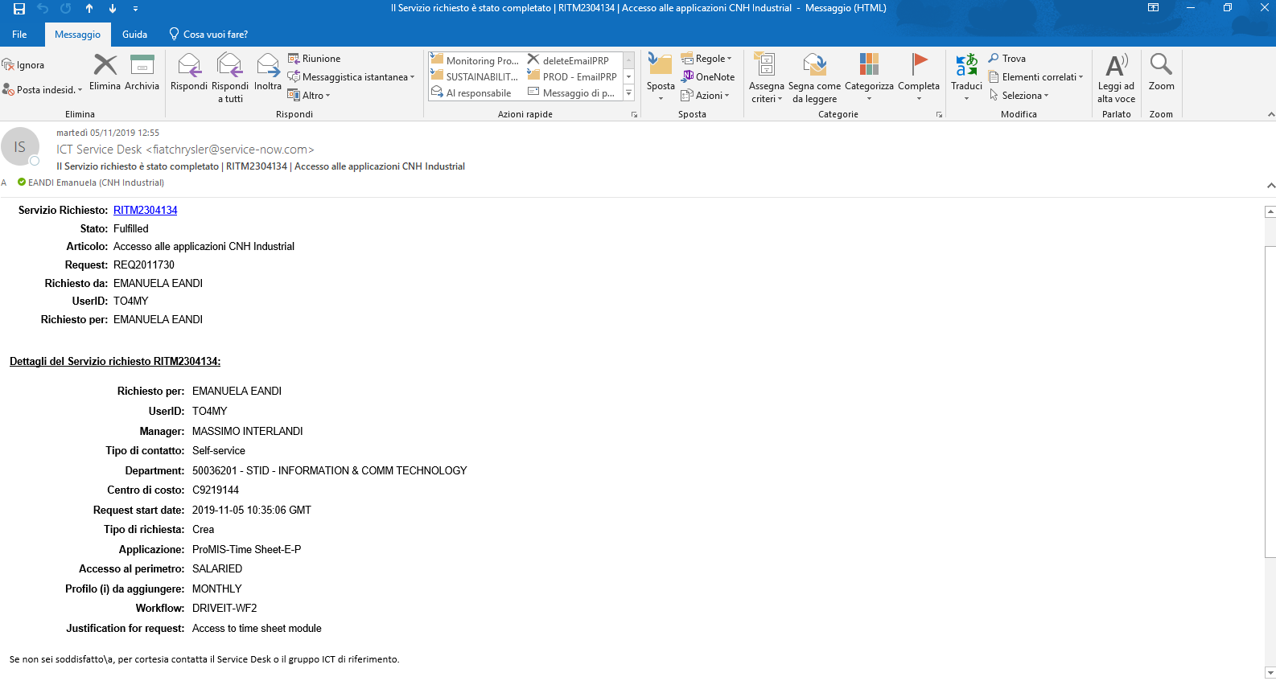
How to open a request for ProMIS TimeSheet access
When the request is closed the system will send a notification email

Slide 10
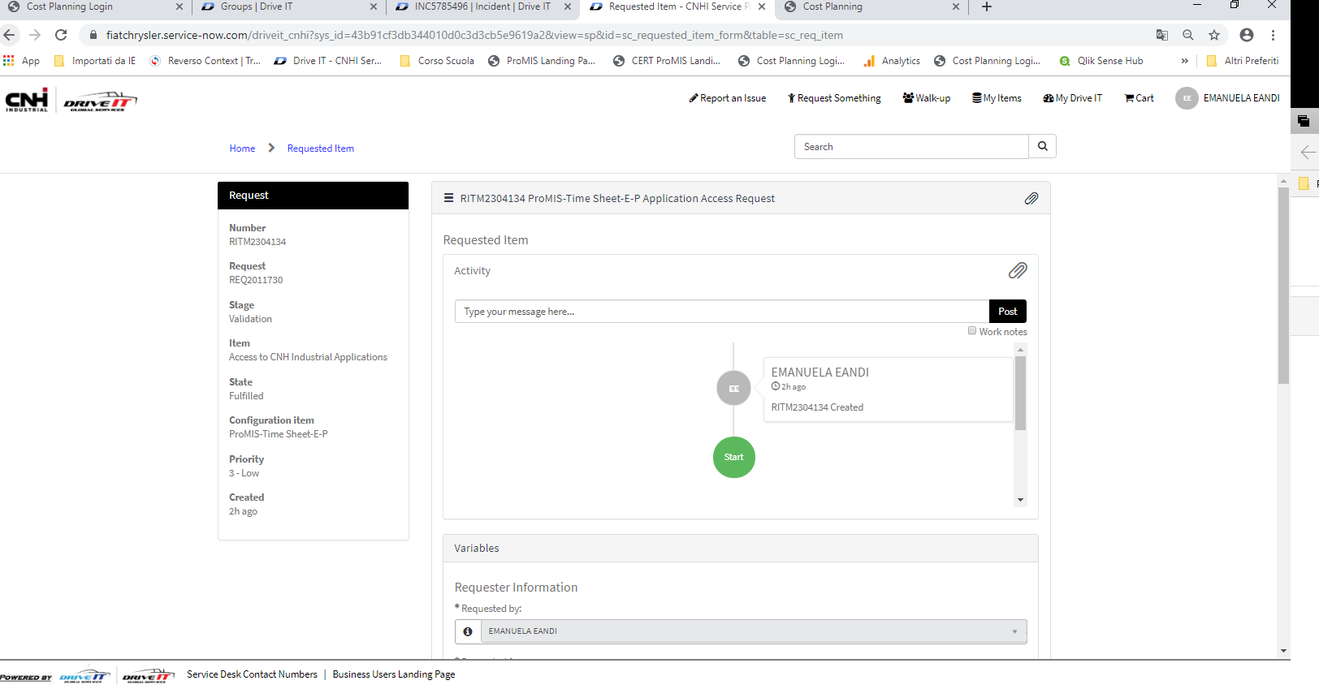
How to open a request for ProMIS TimeSheet access
Request closed

Slide 11
Backup

Slide 12
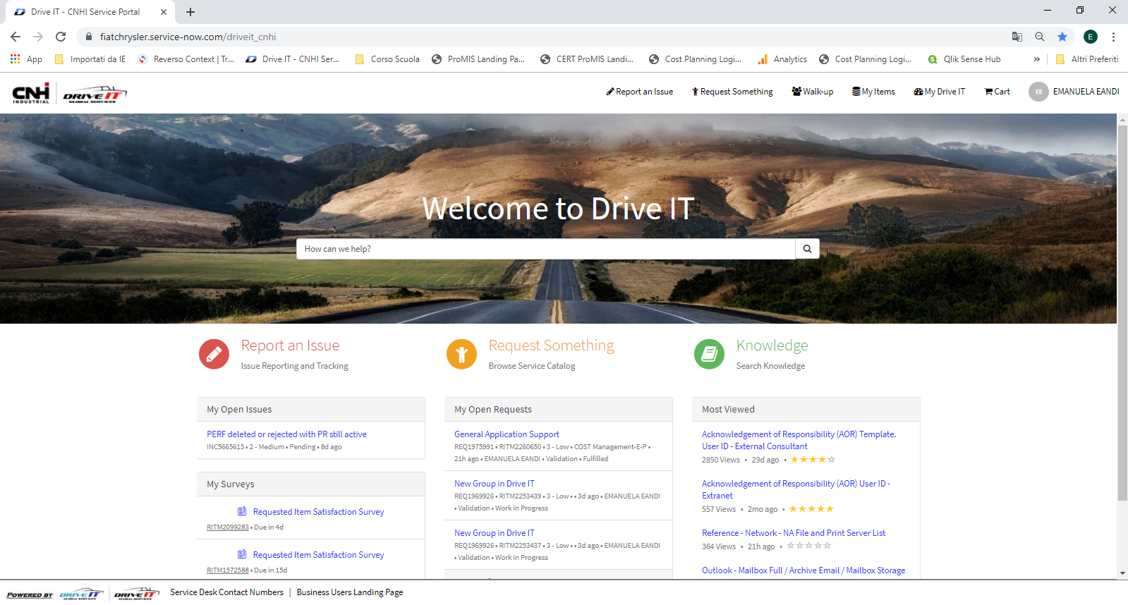
How to open a request for ProMIS TimeSheet access from Drive IT Home page
https://fiatchrysler.service-now.com/driveit_cnhi

Slide 13
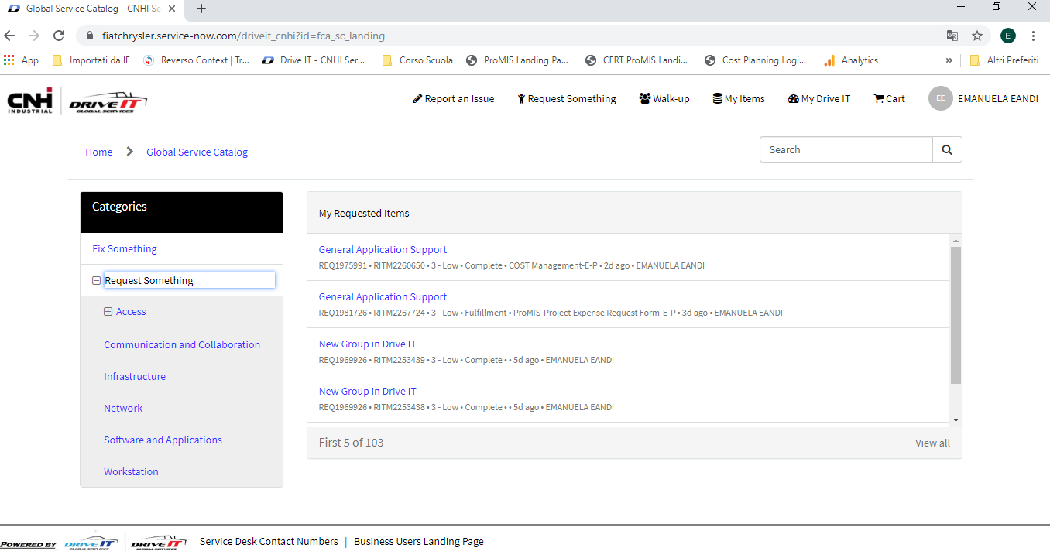
How to open a request for ProMIS TimeSheet access
Select Software and Applications.

Slide 14
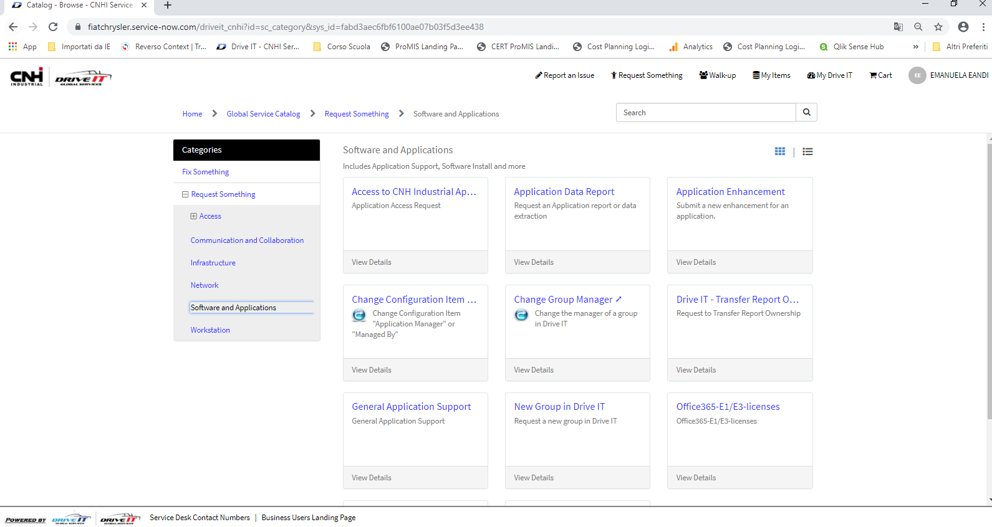
How to open a request for ProMIS TimeSheet access
Select Access to CNH industrial Application.

